Slide 1
LA City Homeless
Exploratory Analysis &
Homeless Service Evaluation Tool
Group 16
Jue Song/Zhuoqun SHENG/Xudong ZHANG

Slide 2
Content
Intro to the Evaluation Tool
Actionable Suggestions
311 Call Response Positivity & Quality
Shelter Functionality
Crime Statistics

Slide 3
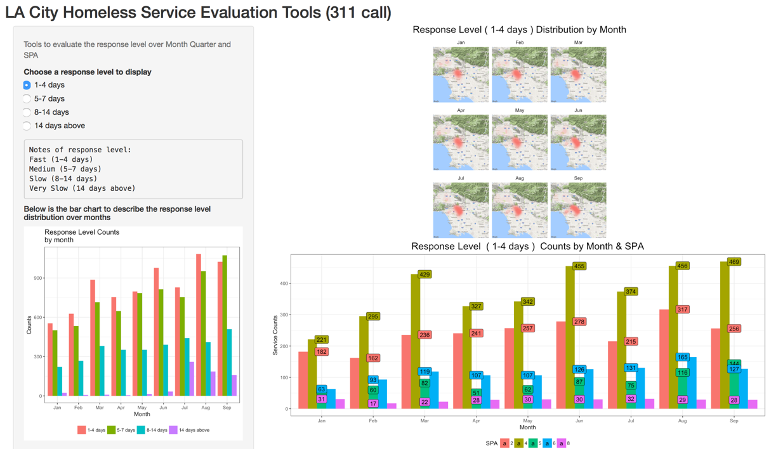
Notes:
as we can see from the bar chart, from 2015-2017, the total number of homeless people has been increasing. in the meantime, the proportion of unsheltered people has also increased, reaching over 70% of the total homeless population.

Slide 4
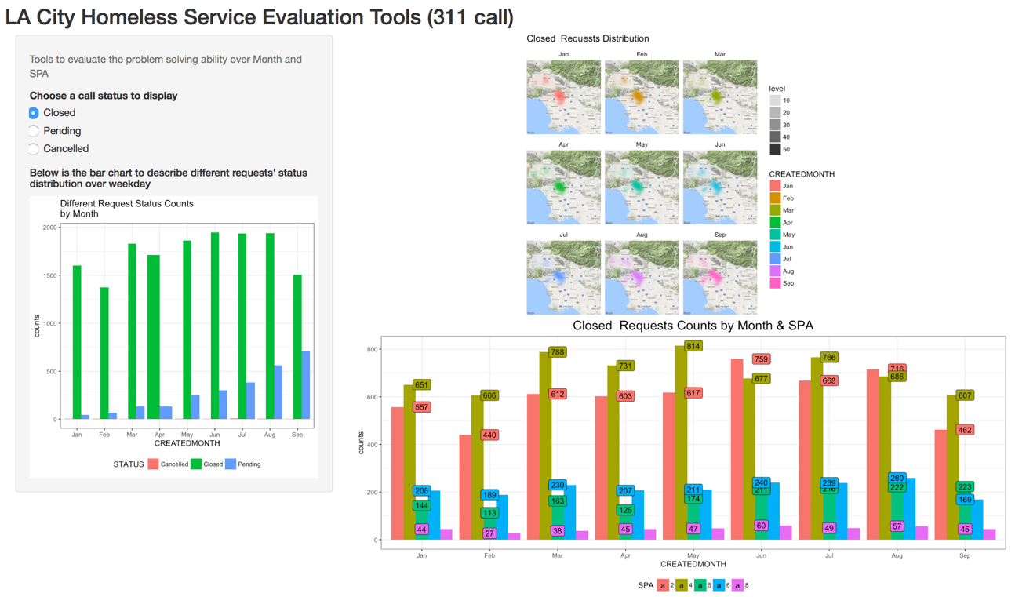

Slide 5
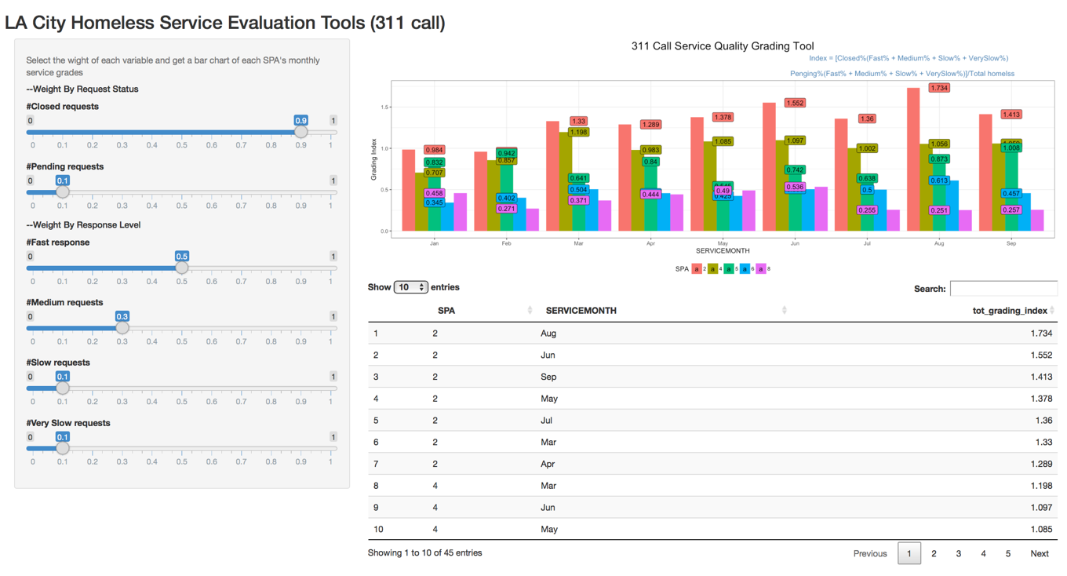
Notes:
First, we look into the time of the crime occurred based on a monthly basis and hourly basis. We found that August has the highest number of crimes, and most of the crime occurred at noon and at night, the peak hours are 12pm and 8pm-1am.
August present an extreme value, we are going to take a deeper at look this month, such as finding crime category happened in this month to get more insights
白天的案件 晚上的案件 哪个区域容易发生哪种案件

Slide 6
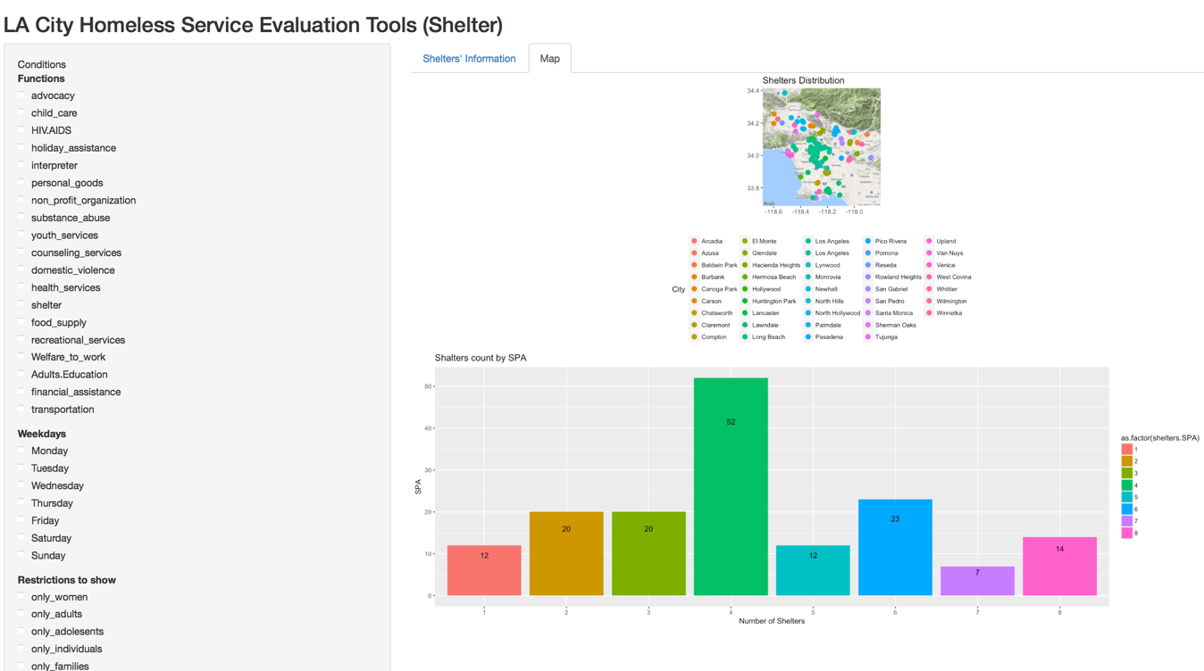
Notes:
Then we looked into the demographic features of the victim. We found that

Slide 7
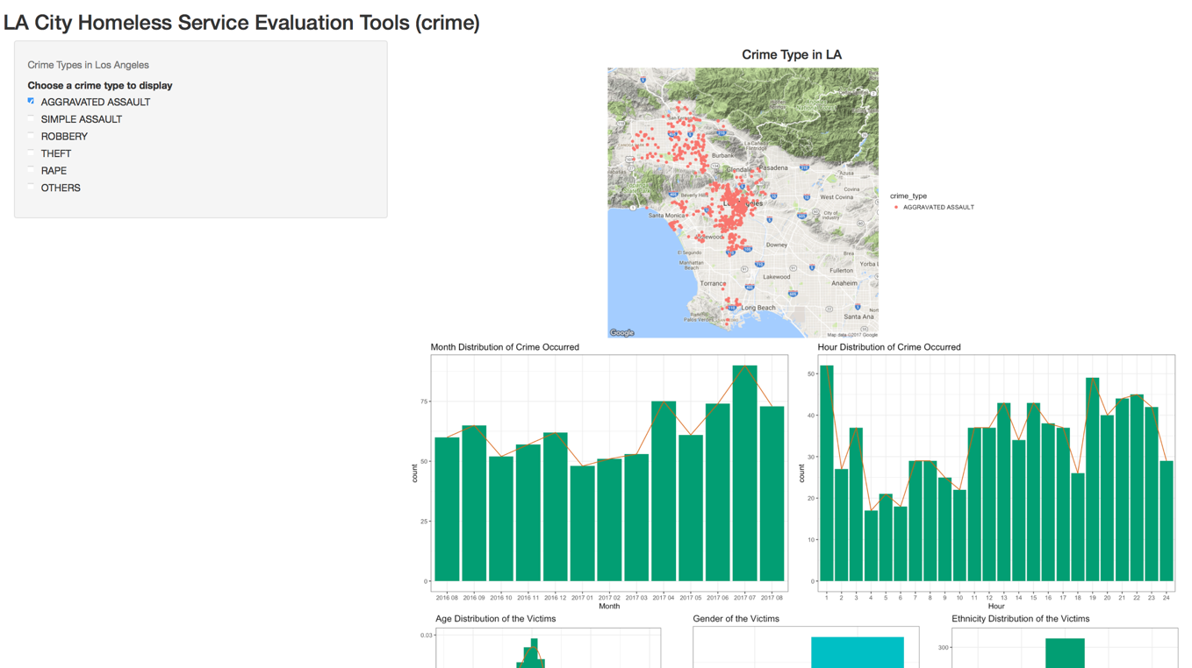

Slide 8
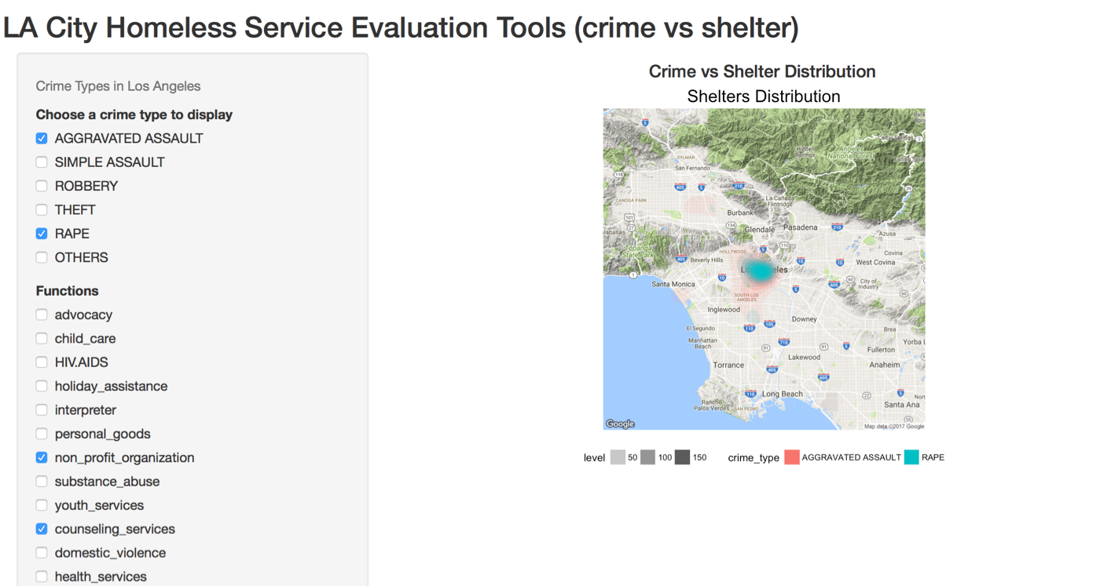

Slide 9
Suggestions
Crime types didn’t change a lot among different months and different hours, indicating the good maintenance of social security.
Several services are not distributed evenly among LA (including child care, personal goods, substance abuse, youth services and financial services). More allocation concern should be put on to this in the future.
311 call pending request are growing in SPA4. The government should study what the cause is and try to fix this. And responses to 311 call from SPA2 are seemingly negatively prioritized in 2017. If this happens conventionally, homeless immigration cross LA SPAs may be stimulated.
A evaluation tool is ready on github !
Link:

Slide 10
Thank you !

